Slide 1

Session III.
Group & Team Theory (cont.)
4. Conflict and Cohesion in Groups

Slide 2
Learning Objectives
Define conflict
Differentiate between functional and dysfunctional conflict
Recognize various types of conflict in groups
Describe the conflict process
Identify and apply strategies for preventing or reducing conflict in groups

Slide 3

Definitions of Conflict
Conflict is defined as an expressed struggle between interdependent parties over goals which they perceive as incompatible or resources which they perceive to be insufficient (Hocker & Wilmot, 2001).
First, conflict must be expressed.
Second, conflict takes place between or among parties who are interdependent - that is, who need each other to accomplish something.
Finally, conflict involves clashes over what people want or over the means for them to achieve it.

Slide 4
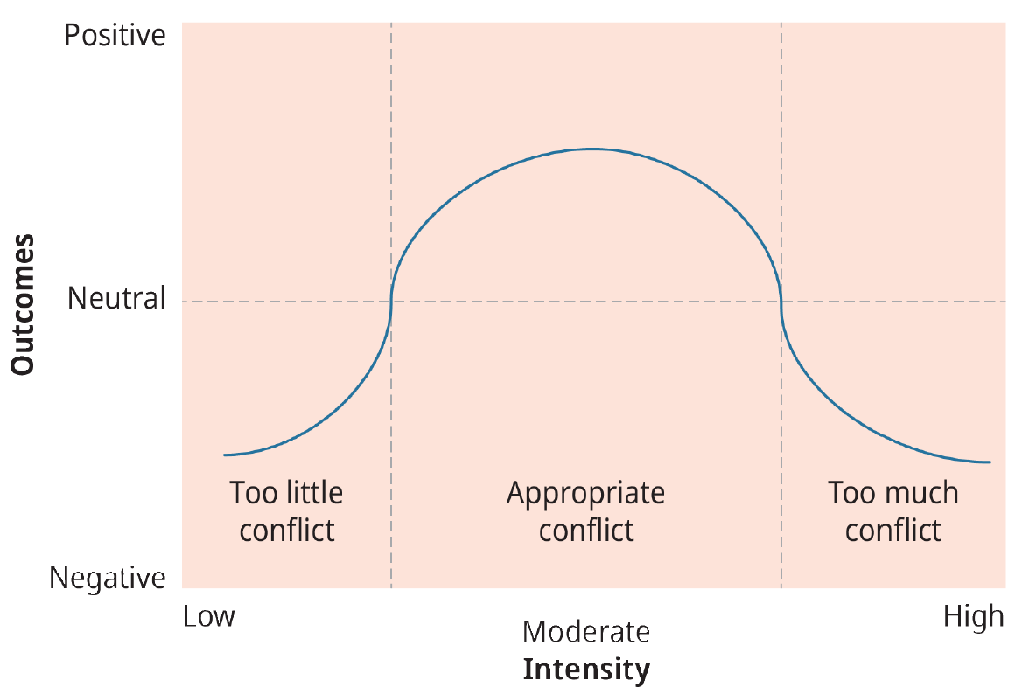
The Positive and Negative Sides of Conflict
Conflict can stimulate innovation and change.
Conflict can help individuals and group members grow and develop self-identities.
The Relationship Between Conflict Intensity and Outcomes. Adapted from Brown (1986). (Credit: Rice University/OpenStax/CC BY-NC-SA 4.0)

Slide 5
The Positive and Negative Sides of Conflict
Conflict, which aims at a resolution of tension between antagonists, is likely to have stabilizing and integrative functions for the relationship.
By permitting immediate and direct expression of rival claims, such social systems can readjust their structures by eliminating their sources of dissatisfaction.
The multiple conflicts which they experience may serve to eliminate the causes for dissociation and to reestablish unity.
These systems avail themselves, through the toleration and institutionalization of conflict, of an important stabilizing mechanism.
The Relationship Between Conflict Intensity and Outcomes. Adapted from Brown (1986). (Credit: Rice University/OpenStax/CC BY-NC-SA 4.0)

Slide 6

Types of Conflict
Conflicts of substance
Conflicts of value
Conflicts of process
Conflicts of misperceived differences
Relationship conflicts

Slide 7
A Model of the Conflict Process
Stage 1: Frustration
Stage 2: Conceptualization
Stage 3: Behavior
Stage 4: Outcome

Slide 8

A Model of the Conflict Process
Stage 1: Frustration
Stage 2: Conceptualization
Stage 3: Behavior
Stage 4: Outcome
The Conflict Process

Slide 9

Stage 1: Frustration
Stage 2: Conceptualization
Stage 3: Behavior
Stage 4: Outcome
A Model of the Conflict Process
STAGE 1: FRUSTRATION
Conflict situations originate when an individual or group feels frustration in the pursuit of important goals.
This frustration may be caused by a wide variety of factors, including disagreement over performance goals, failure to get a promotion or pay raise, a fight over scarce economic resources, new rules or policies, and so forth.
In fact, conflict can be traced to frustration over almost anything a group or individual cares about.

Slide 10
Stage 1: Frustration
Stage 2: Conceptualization
Stage 3: Behavior
Stage 4: Outcome
A Model of the Conflict Process
STAGE 2: CONCEPTUALIZATION
In this stage, parties to the conflict attempt to understand the nature of the problem, what they themselves want as a resolution, what they think their opponents want as a resolution, and various strategies they feel each side may employ in resolving the conflict.
This stage is really the problem-solving and strategy phase.

Slide 11
Stage 1: Frustration
Stage 2: Conceptualization
Stage 3: Behavior
Stage 4: Outcome
A Model of the Conflict Process
STAGE 3: BEHAVIOR
As a result of the conceptualization process, parties to a conflict attempt to implement their resolution mode by competing or accommodating in the hope of resolving problems.
A major task here is determining how best to proceed strategically. That is, what tactics will the party use to attempt to resolve the conflict?
Thomas has identified five modes for conflict resolution: (1) competing, (2) collaborating, (3) compromising, (4) avoiding, and (5) accommodating.

Slide 12

Stage 1: Frustration
Stage 2: Conceptualization
Stage 3: Behavior
Stage 4: Outcome
A Model of the Conflict Process
STAGE 4: OUTCOME
In this stage, both sides determine the extent to which a satisfactory resolution or outcome has been achieved.
Where one party to the conflict does not feel satisfied or feels only partially satisfied, the seeds of discontent are sown for a later conflict.
One unresolved conflict episode can easily set the stage for a second episode. Action aimed at achieving quick and satisfactory resolution is vital; failure to initiate such action leaves the possibility (more accurately, the probability) that new conflicts will soon emerge.

Slide 13

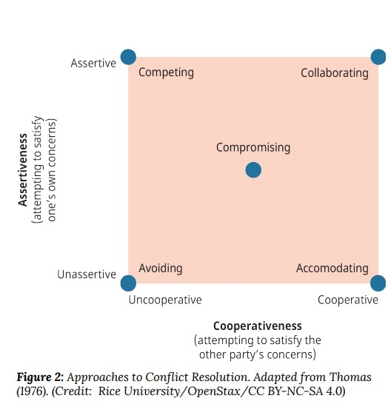
Five Modes of Resolving Conflict

Slide 14

Preventing & Reducing Conflict
04 Strategies for Conflict Prevention
09 Strategies for Conflict Reduction

Slide 15

04 Strategies for Conflict Prevention
1. Emphasizing group goals and effectiveness. Focusing on group goals and objectives should prevent goal conflict. If larger goals are emphasized, group members are more likely to see the big picture and work together to achieve corporate goals.
2. Providing stable, well-structured tasks. When work activities are clearly defined, understood, and accepted, conflict should be less likely to occur. Conflict is most likely to occur when task uncertainty is high; specifying or structuring roles and tasks minimizes ambiguity.

Slide 16
04 Strategies for Conflict Prevention
3. Facilitating dialogue. Misperception of the abilities, goals, and motivations of others often leads to conflict, so efforts to increase the dialogue among group members and to share information should help eliminate conflict.
As group members come to know more about one another, suspicions often diminish, and greater intergroup teamwork becomes possible.
4. Avoiding win-lose situations. If win-lose situations are avoided, less potential for conflict exists.

Slide 17
09 Strategies for Conflict Reduction
1. Physical separation. Separation is useful when conflicting individuals or groups are not working on a joint task or do not need a high degree of interaction. Though this approach does not encourage members to change their attitudes, it does provide time to seek a better accommodation.
2. Use of rules and regulations. Conflict can also be reduced through the increasing specification of rules, regulations, and procedures. Again, however, basic attitudes are not modified.

Slide 18
09 Strategies for Conflict Reduction
3. Use of integrators. Integrators are individuals who are assigned a boundary-spanning role between two people or groups. The integrator often takes the “shuttle diplomacy” approach, moving from one person or group to another, identifying areas of agreement, and attempting to find areas of future cooperation.
4. Limiting intergroup interaction. Another approach to reducing conflict is to limit intergroup interaction to issues involving common goals. Where groups agree on a goal, cooperation becomes easier.

Slide 19
09 Strategies for Conflict Reduction
5. Confrontation and negotiation.
In this approach, competing parties are brought together face-to-face to discuss their basic areas of disagreement. The hope is that through open discussion and negotiation, means can be found to work out problems.
Contract negotiations between union and management represent one such example. If a “win-win” solution can be identified through these negotiations, the chances of an acceptable resolution of the conflict increase.

Slide 20
09 Strategies for Conflict Reduction
6. Third-party consultation.
In some cases, it is helpful to bring in outside consultants for third-party consultation who understand human behavior and can facilitate a resolution. A third-party consultant not only serves as a go-between but can speak more directly to the issues, because she is not a member of the group.
7. Identification of interdependent tasks and superordinate goals. A further strategy is to establish goals that require groups to work together to achieve overall success.

Slide 21
09 Strategies for Conflict Reduction
8. Rotation of members. By rotating from one group to another, individuals come to understand the frames of reference, values, and attitudes of other members; communication is thus increased.
When those rotated are accepted by the receiving groups, change in attitudes as well as behavior becomes possible. This is clearly a long-term technique, as it takes time to develop good interpersonal relations and understanding among group members.

Slide 22
09 Strategies for Conflict Reduction
9. Use of training. The final technique on the continuum is training. Outside training experts are retained on a long-term basis to help groups develop relatively permanent mechanisms for working together.
Structured workshops and training programs can help forge more favorable intergroup attitudes and, as a result, more constructive group behavior.

Slide 23
Review & Reflection Questions
Is conflict in groups good or bad? Why?
Identify the types of conflict and provide examples of each.
What modes of conflict resolution do you find yourself using when faced with a conflict in a group?
What modes have you observed at work in your current group?
What strategies could you use to prevent or reduce conflict in your group?

Slide 24
